Slide 1

La santé planétaire dans la pratique évaluative
I acknowledge with respect the Lekwungen peoples on whose traditional territory the University of Victoria stands, and the Songhees, Esquimalt and WSÁNEĆ peoples whose historical relationships with the land continue to this day.
Présentation au réseau F3E
Astrid Brousselle, Professeure , School of Public Administration, University of Victoria (Canada)
astrid@uvic.ca

Slide 2
Outil d’appréciation rapide pour la santé planétaire

Slide 3
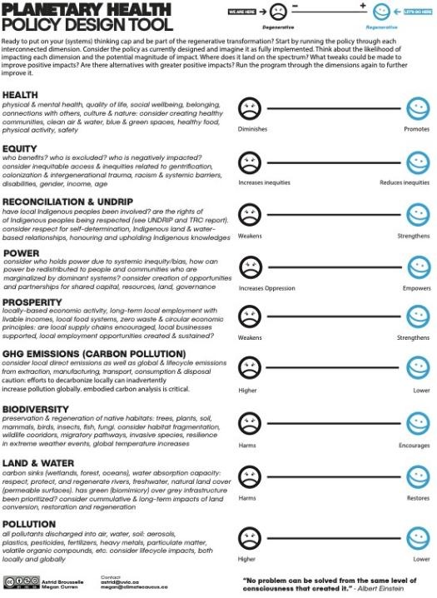
Source: Brousselle et al. (2022); Brousselle & Curren (2022)

Slide 4
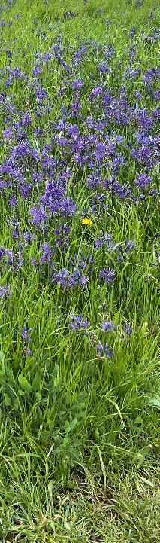
Principes
Co-conception en collaboration avec les utilisateurs cibles. Les dimensions de l’évaluation sont contextualisées en fonction de leurs besoins et que le langage utilisé pour les décrire est pertinent, compréhensible et exhaustif.
Outils conviviaux : pour rendre l’évaluation accessible à tous, quel que soit leur niveau d’expertise.
Perspective du cycle de vie : prise en compte de tous les types d’impacts sur les systèmes naturels et humains, à court et à long terme, de la production à l’élimination.
Délibération et participation
Notes:
Co-design
Co-designing the tool in collaboration with targeted users ensures the assessment dimensions are contextualized according to their needs and that the language used to describe the dimensions is meaningful, understandable, and comprehensive. In addition, co-designing the tools according to the specificity of the context allows governments/organizations to address specific commitments. For example, it would be possible to develop a version specifically addressing the United Nations Sustainable Development Goals, if that was a priority for the organization (Green et al., 2020). However, critical dimensions for planetary health as identified in the Planetary Health framework should all still be considered as these were identified by existing scientific knowledge.
Easy-to-use tools
In EIA and in HIA, two barriers limit their use and impact: experts are needed to conduct the study and eco-social determinants of health are not easy to understand for non-experts. As we want to encourage widespread use of PHRIA tools, a simple tool can empower people to conduct their own assessments without planetary health-related expertise or knowledge. To make the assessment exercise accessible to non-experts, PHRIA tools should include some language describing what each planetary dimension encompasses. In particular, to circumvent the difficulties experienced in HIA and EIA, it is important how the dimensions of health, equity, and power relations are described.
Deliberation and engagement
Once created, the tool should be implemented and used in deliberation with different groups such as elected officials, administrators, and decision-makers, but also diverse interest groups, such as industrial groups, Indigenous leaders, beneficiaries, and community members. Sharing the tool with a diversity of individuals and groups early in the process is a way to increase the credibility of the exercise, and to enhance deliberation around potential trade-offs. The trade-offs among which dimensions to prioritize over others wouldn’t be the result of an expert’s decision, instead this would be informed by the positions of various groups and the debate taking place. Furthermore, assessing a project using a PHRIA tool may also surface alternatives with potentially higher positive impacts for consideration. Larger participation would also help in controlling individual rating bias.
Life-cycle perspective
Finally, with the purpose of the intervention in mind, we would like to re-emphasize that all kinds of impacts on natural and human systems, in both the short and long term, should be included. In addition, the impact assessment of projects, programs or policies shouldn’t be limited to their implementation or production processes. Limiting the scope of the assessment could derail the process. Pre-selecting a stage or part of the project for evaluation purposes inevitably leads to missing the purpose of exercise itself. A life-cycle perspective should be adopted.

Slide 5
Source: Brousselle et al. (2022)

